Slide 1
Exegetical Outlining
33
Part 2:
Z₁+X+Z₂+Y Form
Dr. Rick Griffith • Jordan Evangelical Theological Seminary • BibleStudyDownloads.org

Slide 2
Sodom Experience (Gen. 19)
Your critique?
We often have to learn the hard way before we realize God knew best after all.
When Lot went to Sodom, he went for his own interest and pleasure, not to witness for God.
(Abram, as a type of Christ, interceded for Lot, who is a type of the last days' church.)
III. The sin of Sodom that caused its destruction was homosexuality.
IV. 2 Peter 2:7-8 says that Lot was a righteous man, which refers to his position in Christ, not his actions.
Conclusion: How much of your old life is left in you?
Notes:
Positive:
He seeks to preach it in context of Lot’s motive in earlier chapters.
He is not afraid to tackle the issue of homosexuality.
He attempts to apply the passage.
Negative:
Lack of focus
Outline not based on movements of the text
Reads NT theology into the OT

Slide 3

What do you do for a living?
What do you do for a living?
I work.

Slide 4
Could you be more vague?
Could you be more vague?
Be specific!

Slide 5
The Preparing Expository Sermons Process
27-28, 251
Based on Ramesh Richard's text, Preparing Expository Sermons
TEXT
SERMON
5 Desired Listener Response
Brain
4 The Three
Developmental
Questions
Purpose Bridge
3.2 Exegetical Idea
CPT
Heart
CPS
6 Homiletical Idea
7 Homiletical
Outline
8 Clarity
9 Intro/Concl
3.1 Exegetical
Outline
Structure
Skeleton
Structure
2 Analyze Text
Study
Flesh
Preach
10 MSS &
Preach
1 Choose Text
White text shows 10 steps adapted from Haddon Robinson, Biblical Preaching (notes, 105)
Notes:
Cover steps 1-3 on page 27

Slide 6
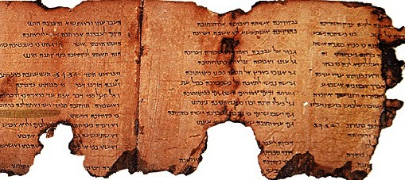
Sometimes our Main Idea has missing elements.
Z1+X+Z2+Y
How can we be clearer?
Notes:
This manuscript has missing sections on the top, bottom, and end—just like our study of a passage can skip segments.

Slide 7
Forming the Exegetical Idea (CPT)
29
Subject
(Theme)
Complement
(Thrust)
The Question
The Answer
The reason people should praise God…
The test of a person's character…

Slide 8

What is the Z1+X+Z2+Y Form?
33
Subject
(Z1+X)
Complement
(Z2+Y)
"The"
+
qualifiers
"is" +
matching
qualifier
Theme
Sub-theme
WARNING:
Writing statements in this four-point form forces you to be crystal clear on what you think a section of Scripture means!
However, you could be clear but wrong––so still use good hermeneutics!
Notes:
Start the sentence with the word "the."

Slide 9
Example 1 of Z1+X+Z2+Y Form
33
Z1 | X | Z2 | Y
 | Triumph over Satan |  | trust in Christ
The means by which (i.e. "The way…" | God provides triumph over Satan | is by | enabling us to trust in Christ alone
The means by which | we must fearlessly trust Christ | is by | trusting His provisions instead of our own
Notes:
Translators, please select the 8 black boxes over the text above and move them to the side so you can translate the text. Then move them back and check your work with the animations in slide show mode.

Slide 10
Example 2 of Z1+X+Z2+Y Form
33
Z1 | X | Z2 | Y
The means by which (i.e., How can we…) | we triumph over Satan | is by | trusting His provisions instead of our own
The reason (i.e., Why can we…) | we can feel secure | is because | God is with us and is stronger than Satan
Notes:
Translators, please select the 8 black boxes over the text above and move them to the side so you can translate the text. Then move them back and check your work with the animations in slide show mode.

Slide 11
Example 3 of Z1+X+Z2+Y Form
33
Z1 | X | Z2 | Y
The reason | God is trustworthy | is because | God is our deliverer and is stronger than Satan
The reason | we can live victoriously | is because | God helps us fight Satan
Notes:
Translators, please select the 8 black boxes over the text above and move them to the side so you can translate the text. Then move them back and check your work with the animations in slide show mode.

Slide 12
Checking Z1+X+Z2+Y Form
33
Z1 | X | Z2 | Y
 | Triumph over Satan |  | Trust in Christ
The means by which (i.e. "The way..." | God provides triumph over Satan | is by | enabling us to trust in Christ alone
The means by which | we must fearlessly trust Christ | is by | trusting His provisions instead of our own
Notes:
This works well in English to take out the Z1 and the "to be" verb.

Slide 13
Checking Z1+X+Z2+Y Form
33
Z1 | X | Z2 | Y
The reason | God is trustworthy | is because | God is our deliverer and is stronger than Satan
The reason | we can live victoriously | is because | God helps us fight Satan

Slide 14
Homiletical Questions & Qualifiers
34
Who
Z1 | Z2
The one(s) to/for/by whom … | is (are) the …

Slide 15
Homiletical Questions & Qualifiers
34
Z1 | Z2
The advantage(s) of… The characteristic(s) of… The content of… The evidence of… The extent to which… The identity of… The nature of… The object of… The problem of…/solution to… The quality(ies) of… The response of… The result(s) of… The setting of… The test of… | is (was/are) …
What

Slide 16
Homiletical Questions & Qualifiers
34
Where
Z1 | Z2
The… | is (are) the…
When
Why
Under what condition
How

Slide 17
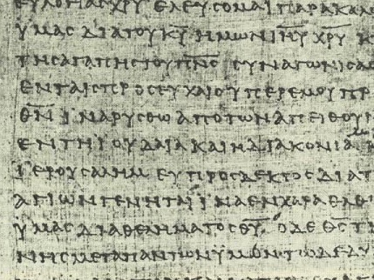
How do you know which qualifier to use?
34
Look for key connectives in the text (e.g., "and," "but," "so that," "because," etc.).
Match them with the right Z₁ and Z₂.
Use them in an EI that translates figures of speech.
"Put on the full armor of God so that you can take your stand against the devil's schemes."
"The purpose for consistent spiritual disciplines is so that we can defend ourselves against Satan's attacks."

Slide 18
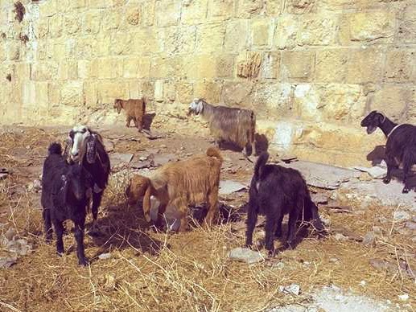
What kind of animal are you?

Slide 19

Psalm 23
¹The LORD is my shepherd, I shall not be in want. ²He makes me lie down in green pastures, he leads me beside quiet waters, ³he restores my soul. He guides me in paths of righteousness for his name's sake. ⁴Even though I walk through the valley of the shadow of death, I will fear no evil, for you are with me; your rod and your staff, they comfort me. ⁵You prepare a table before me in the presence of my enemies. You anoint my head with oil; my cup overflows. ⁶Surely goodness and love will follow me all the days of my life, and I will dwell in the house of the LORD forever.

Slide 20
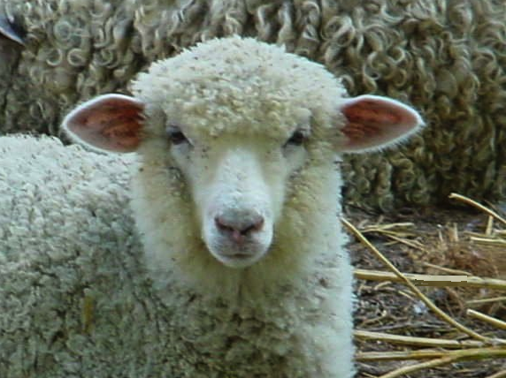
You're a sheep

Slide 21
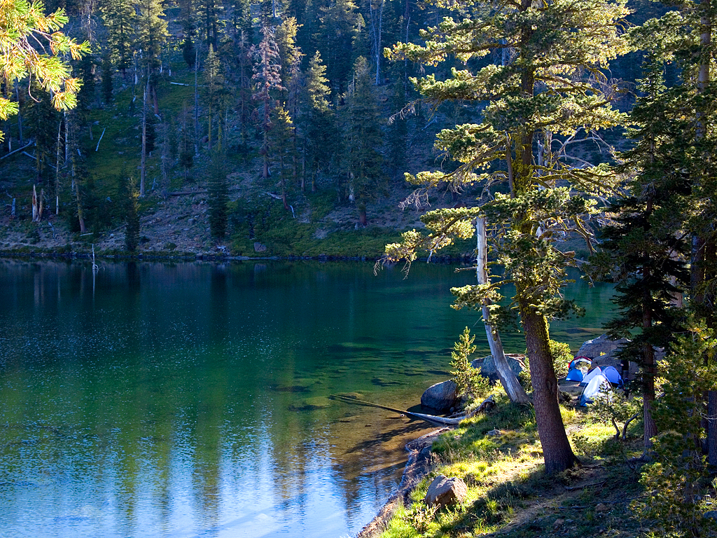
He leads me beside still waters

Slide 22
Psalm 23
¹The LORD is my shepherd, I shall not be in want. ²He makes me lie down in green pastures, he leads me beside quiet waters, ³he restores my soul. He guides me in paths of righteousness for his name's sake. ⁴Even though I walk through the valley of the shadow of death, I will fear no evil, for you are with me; your rod and your staff, they comfort me. ⁵You prepare a table before me in the presence of my enemies. You anoint my head with oil; my cup overflows. ⁶Surely goodness and love will follow me all the days of my life, and I will dwell in the house of the LORD forever.

Slide 23
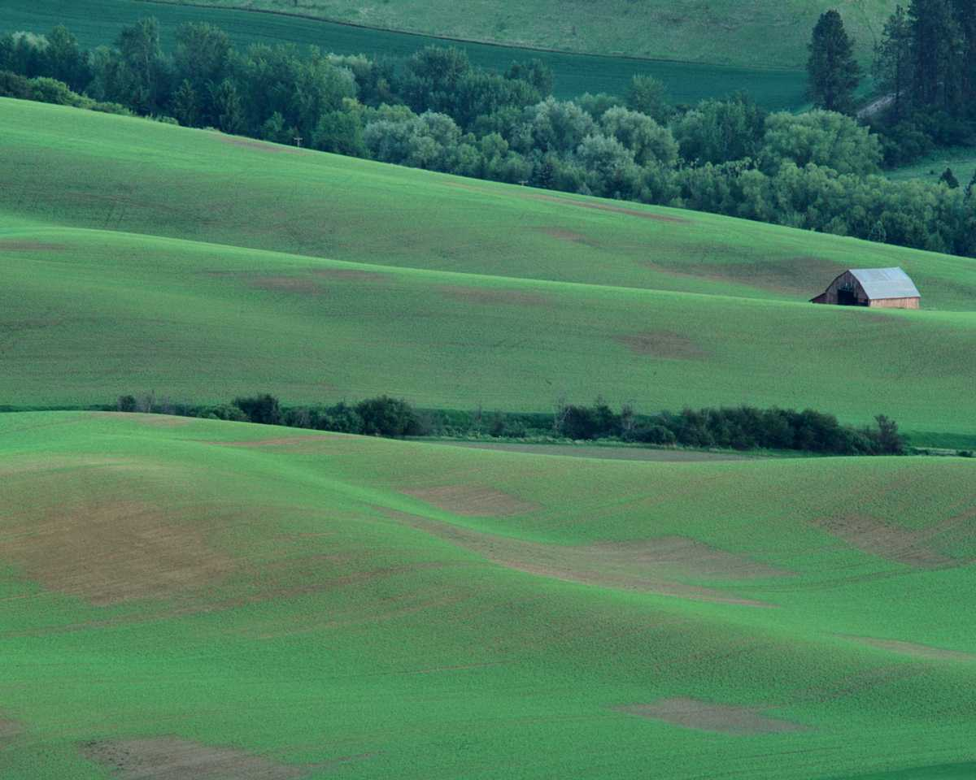
Psalm 23 Exegetical Outline
46
I. The response of David to God's provision & protection [like a shepherd for his sheep] was comfort instead of fear (1-4).
      A. The way the LORD satisfied David was by
      providing all of his needs (1-3).
      1. The LORD provided quality physical food, rest and water that satisfied David (1-2) .
      2. The LORD provided spiritual refreshment that restored David's soul (3a) .
      3. The LORD provided guidance in holiness to protect His own name (3b) .
      B. The response of David to the LORD protecting him in dangerous situations was a lack of fear (4).

Slide 24
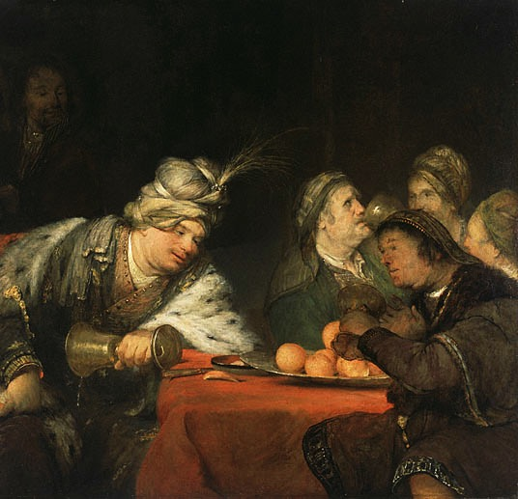
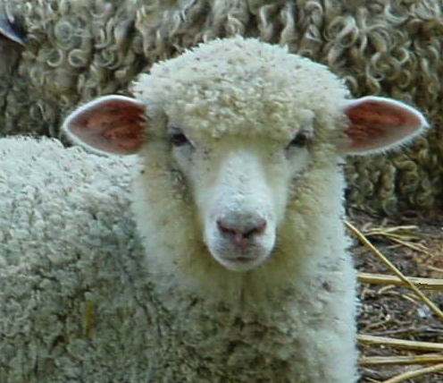
"He prepares a table before me in the presence of my enemies" (v. 5)
or
?
Sheep
Banqueting Victor

Slide 25
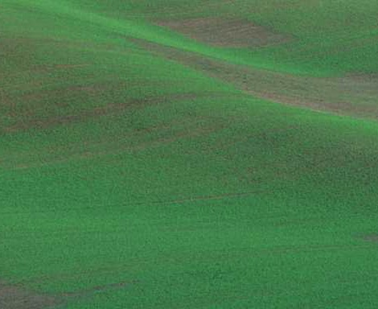
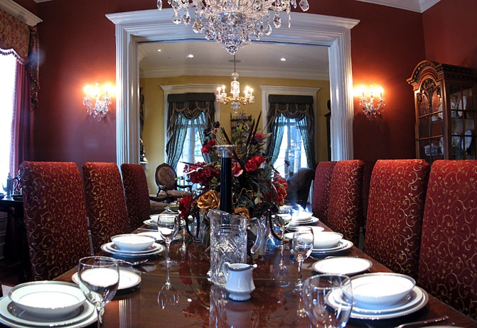
"He prepares a table before me in the presence of my enemies" (v. 5)
or
?
"Banquet" of grass
Literal banquet

Slide 26
Psalm 23 Exegetical Outline
46
    II. The manner in which God showed His goodness to David was by exalting him like honoring a banqueting victor before his enemies (5).
      A. The LORD protected & exalted David like a banqueting victor before humbled enemies (5a).
      B. The LORD honored David (5b).
      C. The LORD provided more blessings than David could possibly enjoy (5c).
"You prepare a table before me in the presence of my enemies"
"You anoint my head with oil"
"My cup overflows"

Slide 27
Psalm 23
¹The LORD is my shepherd, I shall not be in want. ²He makes me lie down in green pastures, he leads me beside quiet waters, ³he restores my soul. He guides me in paths of righteousness for his name's sake. ⁴Even though I walk through the valley of the shadow of death, I will fear no evil, for you are with me; your rod and your staff, they comfort me. ⁵You prepare a table before me in the presence of my enemies. You anoint my head with oil; my cup overflows. ⁶Surely goodness and love will follow me all the days of my life, and I will dwell in the house of the LORD forever.

Slide 28
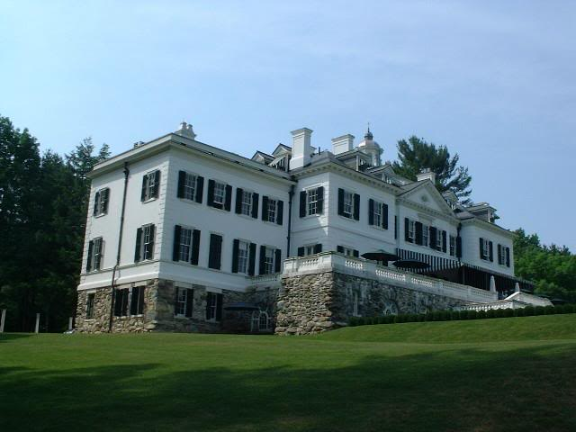
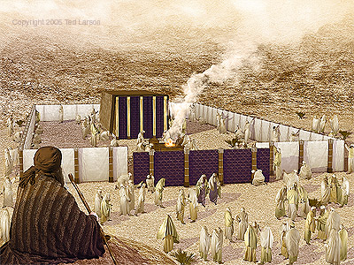
What is dwelling
"in the house of the Lord forever"?
or
?
Living in heavenly house
Tabernacle worship

Slide 29
Psalm 23 Exegetical Outline
46
    III. The response of David to God's continued goodness was to commit to commune with the LORD at the tabernacle the rest of his life (6).
      A. David expressed confidence that the LORD would show goodness towards him the rest of his life (6a).
      B. David's response was to commit to commune with God at the tabernacle the rest of his life (6b).

Slide 30
Psalm 23 Exegetical Outline
46
Exegetical Idea: The response of David to God's goodness shown in providing for and exalting him was to fearlessly commune with God at the tabernacle the rest of his life.
    The response of David to God's provision and protection [like a shepherd does for his sheep] was comfort instead of fear (1-4).
    The manner in which God showed His goodness to David was by exalting him like honoring a banqueting victor before his enemies (5).
    The response of David to God's continued goodness was to commit to commune with the LORD at the tabernacle the rest of his life (6).

Slide 31
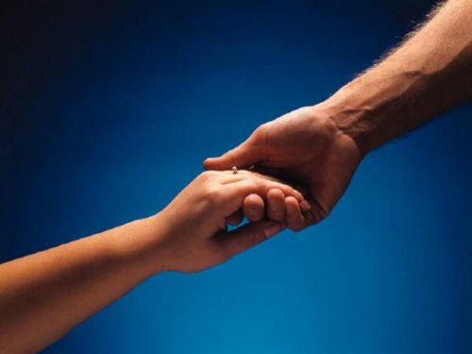

How to Restore Relationships
Matthew 18:15-20
Exegetical Outline
10 December 2006
6 March 2011
Notes:
HOM 09.31 EO only
HOM 16.11
HSB 20.31
HSB 25.07

Slide 32
Matthew 18:15-20 (NIV 1984 ed.)
If your brother sins against you, go and show him his fault, just between the two of you. If he listens to you, you have won your brother over. ¹⁶But if he will not listen, take one or two others along, so that 'every matter may be established by the testimony of two or three witnesses.' ¹⁷If he refuses to listen to them, tell it to the church; and if he refuses to listen even to the church, treat him as you would a pagan or a tax collector.
¹⁸I tell you the truth, whatever you bind on earth will be bound in heaven, and whatever you loose on earth will be loosed in heaven. ¹⁹Again, I tell you that if two of you on earth agree about anything you ask for, it will be done for you by my Father in heaven. ²⁰For where two or three come together in my name, there am I with them.
How to Restore
15-17
Why to Restore
18-20
Notes:
In Matthew 18:15-20 Jesus provides God's plan for loving church discipline. Let's read it together [read 15-20.] This text has two main teachings on restoring Christians in sin.
• Verses 15-17 give how to restore them and…
• Verses 18-20 give why to restore them.
Let's first see how to restore relationships. God's way to restore believers in sin is to…
__________________
BS-18-Exegetical Idea1-slide 15
BS-19-Exegetical Idea2-slide 32
BS-26-Applications-10 focuses only on verses 15-17
NS-01-Matt15-28-slide 33
PR-08-Exegetical Idea1-slide15
PR-09-Exegetical Idea2-slide 32
PR-16-Applications-12 focuses only on verses 15-17

Slide 33
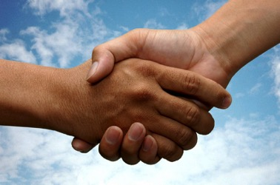
I. The manner in which the church should correctly restore a sinning Christian is by keeping the matter as private as possible (15-17).
34c
  A private sin should be dealt with only between those directly involved so as to make restoration of the offender easier (15).
  Unrepentant sin after a private confrontation should be exposed only to one or two more persons in order to facilitate restoring the sinner (16).
  Unrepentant sin after a small group attempt at restoration should be brought before the entire church body as a deterrent to continued sin (17a).
  Unrepentant sin after exposure to the church should result in requiring each church member to relate to the sinner as an unbeliever (17b).
Notes:
PR 09.33
BS 20.33; 25.09
NS Mt 15.8

Slide 34
Exegetical Idea: The reason the church should restore a sinning Christian correctly is because it extends God's authority.
34c
  Churches that prayerfully restore or continue to seek to restore sinful believers act in the place of the Father (18-19).
    The church must announce guilt or innocence based upon what God has already determined (18).
    Church leaders who prayerfully make a judgment can have confidence that they have acted according to God's will (19).
  Churches that restore or continue to seek to restore sinful believers act in the presence of Jesus (20).
Notes:
PR 09.34
BS 20.34; 25.10
NS Mt 15.9

Slide 35

Exegetical Idea: The reason the church should restore a sinning Christian correctly is because it extends God's authority.
34c
  The manner in which the church should correctly restore a sinning Christian is by keeping the matter as private as possible (15-17).
  The reason the church can restore or continue to seek to restore errant believers is because it extends the authority of God Himself (18-20).
Matthew 18:15-20
Notes:
PR 07.15. 09.35; 11.25; 12.16; 16:11 HO subject only
BS 18.43; 20.31; 25.11
NS Mt 15.10

Slide 36
Black

Slide 37


Preaching (Homiletics) link at BibleStudyDownloads.org
Get this presentation for free!
Notes:
Preaching (pr)
Homiletics

